Slide 1


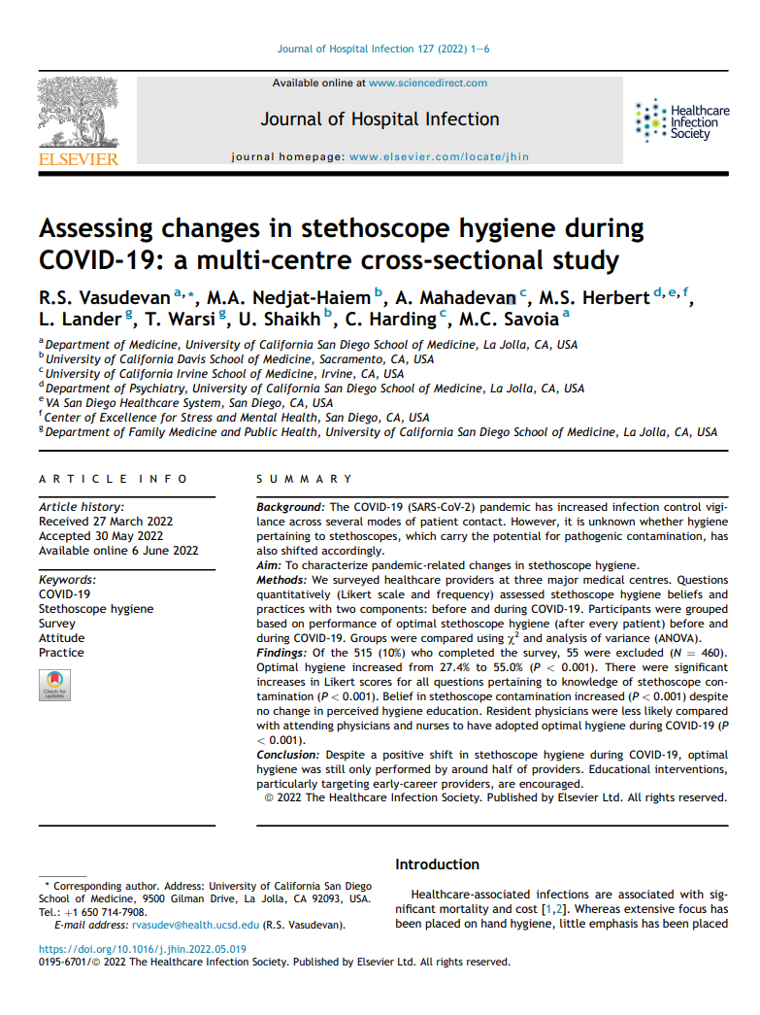

Evidence-Based Selling Assessing changes in stethoscope hygiene during COVID-19: a multi-centre cross-sectional study R.S. Vasudevan, M.A. Nedjat-Haiem, A. Mahadevan, M.s. Herbert, L. Lander, T. Warsi, U. Shaikh, C. Harding, M.C. Savoia
“Our staff already cleans their
stethoscopes with alcohol.”

Slide 2

Before We Start
Common Comment
”Oh, so you guys came out with this because of COVID?”
Diminishes The DiskCover System to an opportunistic commodity designed to take advantage of the pandemic
(Such as gloves, gowns, goggles, face shields, respirators, etc.)

Slide 3

Before We Start
Suggested Response
”Actually, The DiskCover System was first conceptualized back in 2016 when AseptiScope was founded, based on decades of existing data on the stethoscope diaphragm being an unaddressed, potent vector.”
You, the GigaChad AseptiScope Representative
Founding date and mounting data long preceded COVID

Slide 4

Methods
A Likert Scale survey at three major medical centers anonymously assessed physicians, nurses, and PAs stethoscope hygiene beliefs/practices:
Before COVID-19
During COVID-19
(n=460) Valid Survey Responses
33 Questions asking providers about frequency of stethoscope use, perceptions of safety, and pathogen transmission associated with stethoscopes.
Vasudevan, R.S., et al. “Assessing changes in stethoscope hygiene during COVID-19: A multi-centre cross-sectional study.” Journal of Hospital Infection, vol. 127, Sept. 2022, pp. 1–6.

Slide 5
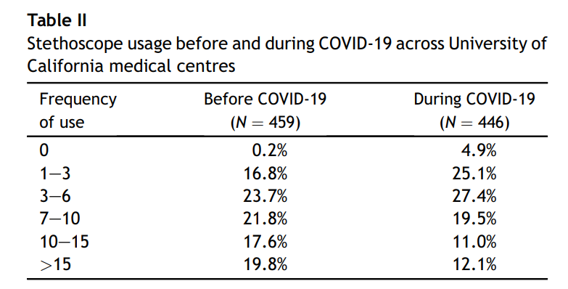
Results
Stethoscope Usage Frequency
Respondent Results:
There was a decrease in “Higher Frequencies of Stethoscope Usage”
There was a significant increase in “Cleaning after every patient”
Vasudevan, R.S., et al. “Assessing changes in stethoscope hygiene during COVID-19: A multi-centre cross-sectional study.” Journal of Hospital Infection, vol. 127, Sept. 2022, pp. 1–6.

Slide 6

Results
Knowledge & Beliefs
Respondent Results:
Majority agreed stethoscope is important in evaluation of patients before COVID.
Likert Scores significantly decreased in perceptions during COVID of:
“The stethoscope makes patients feel safe”
Significant increase on knowledge about stethoscope contamination during COVID
Vasudevan, R.S., et al. “Assessing changes in stethoscope hygiene during COVID-19: A multi-centre cross-sectional study.” Journal of Hospital Infection, vol. 127, Sept. 2022, pp. 1–6.

Slide 7
Results
KEY POINT
“However, respondents reported decreased confidence in their ability to clean a stethoscope.”
“Furthermore, there was also a decrease in belief that current methods of stethoscope hygiene are adequate.”
Vasudevan, R.S., et al. “Assessing changes in stethoscope hygiene during COVID-19: A multi-centre cross-sectional study.” Journal of Hospital Infection, vol. 127, Sept. 2022, pp. 1–6.

Slide 8
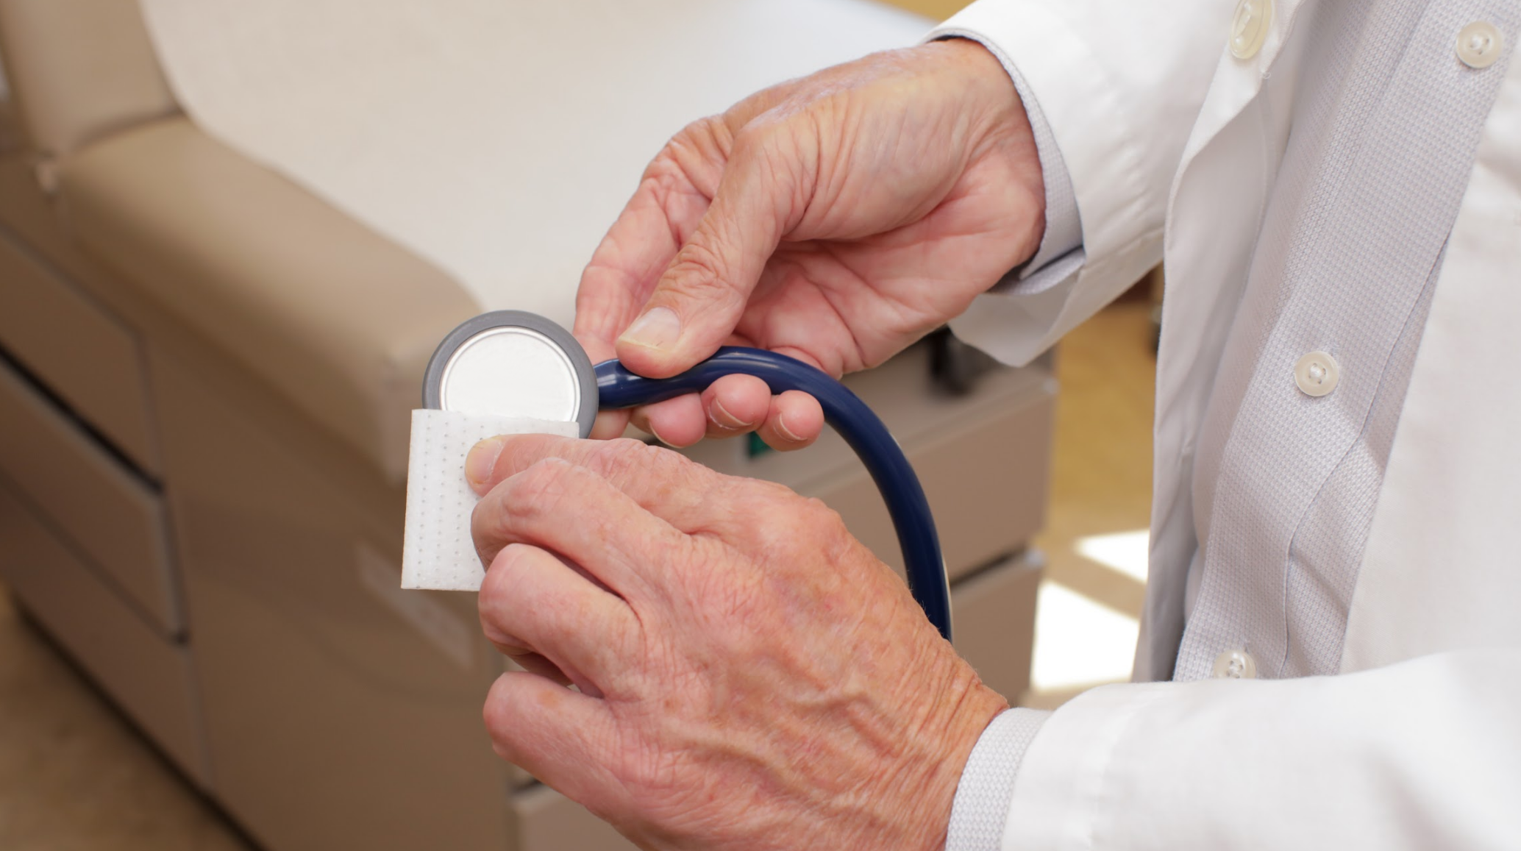
Results
Predicting Cleaning Habits
Optimal Cleaners: Cleaned ‘after every patient’ (AEP) before and during COVID.
Influenced Cleaners: Did not clean AEP before COVID, but did so during COVID.
Suboptimal Cleaners: Did not clean ‘after every patient’ either before or during COIVD.
The following factors were significant covariates in our model:
Female provider
Belief that contaminated stethoscopes present a danger on patients
Having adequate access to cleaning supplies
Believing that current methods of stethoscope hygiene are adequate
Vasudevan, R.S., et al. “Assessing changes in stethoscope hygiene during COVID-19: A multi-centre cross-sectional study.” Journal of Hospital Infection, vol. 127, Sept. 2022, pp. 1–6.

Slide 9
Discussion
There was a significant shift in several stethoscope hygiene practices and beliefs.
However… 45% of physicians reported not performing optimal hygiene during COVID-19.
Vasudevan, R.S., et al. “Assessing changes in stethoscope hygiene during COVID-19: A multi-centre cross-sectional study.” Journal of Hospital Infection, vol. 127, Sept. 2022, pp. 1–6.

Slide 10


Conclusion
Despite a positive shift in stethoscope hygiene during COVID-19, optimal hygiene was still only performed by around half of providers.
vs. Disposables

Slide 11
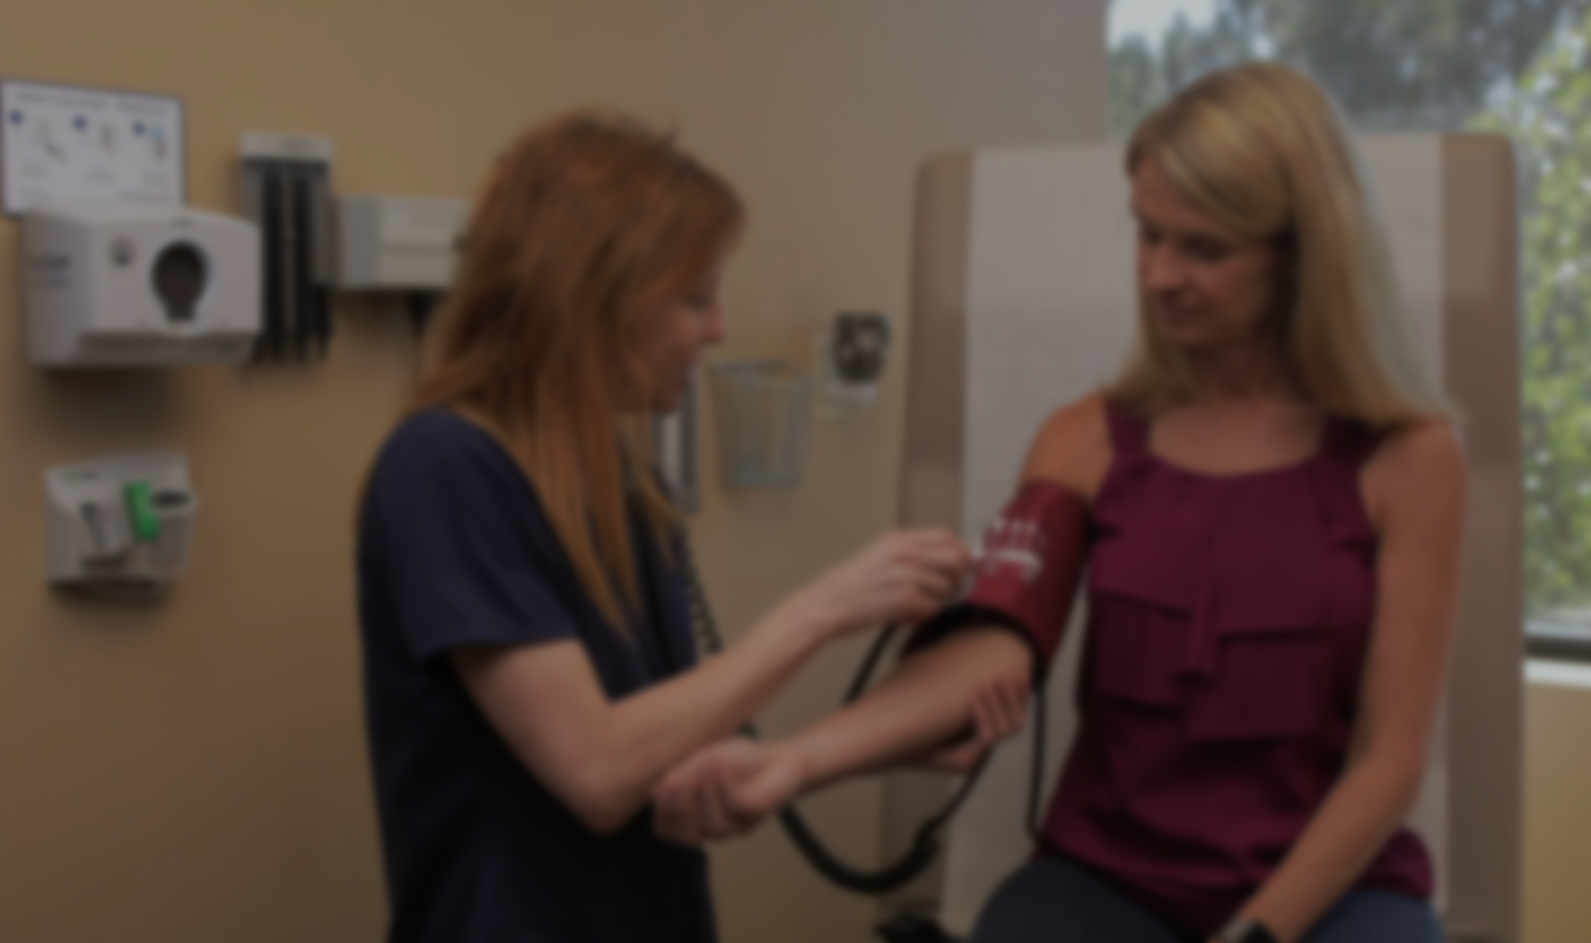
Key Points to Remember
COVID-19 made clinicians more aware of the stethoscope as a vector.
There was decreased confidence in clinicians’ ability to clean their stethoscope
There was a decrease in belief in adequacy of current stethoscope hygiene methods

